Slide 1

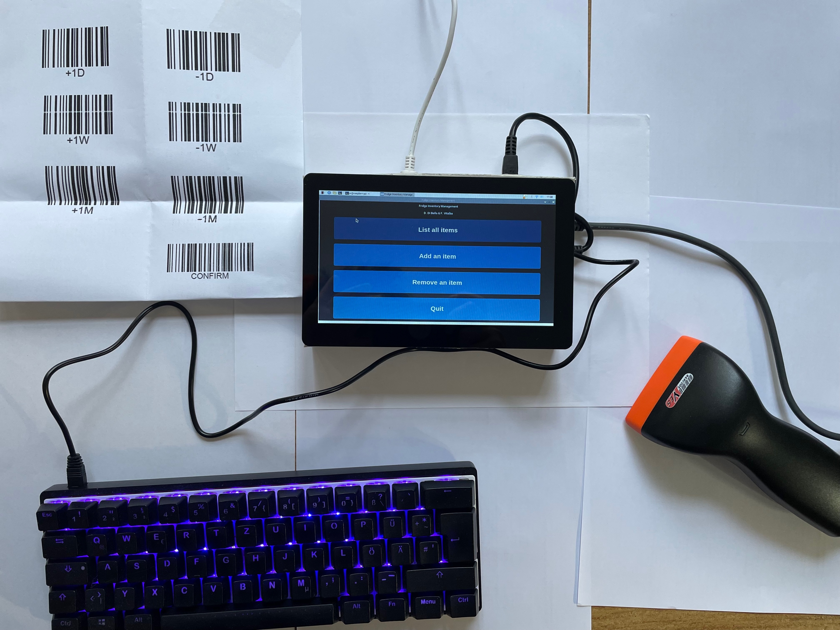
Basics of Physical computing:
Maker Lab
TITLE:
FIM
Group #45
Daniel F. Di Bella
Fabio Vitalba
Faculty of Engineering, Free University of Bozen-Bolzano
fvitalba@unibz.it
ddibella@unibz.it
MakerLab Final project
2023-2024

Slide 2
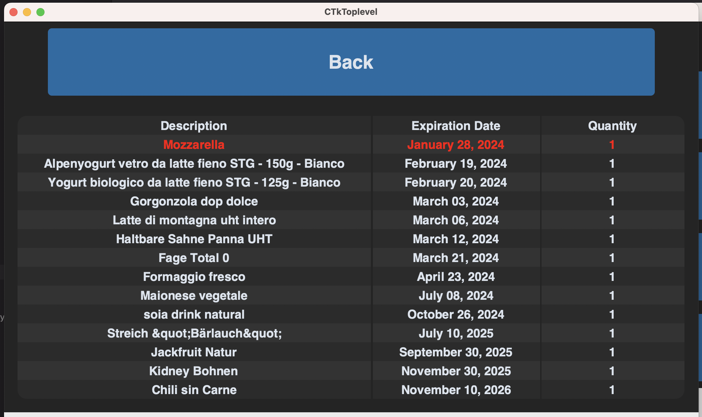
FIM: The Idea
FIM is a tool to reduce food waste in households,
while providing an overview of the stored items.

Slide 3
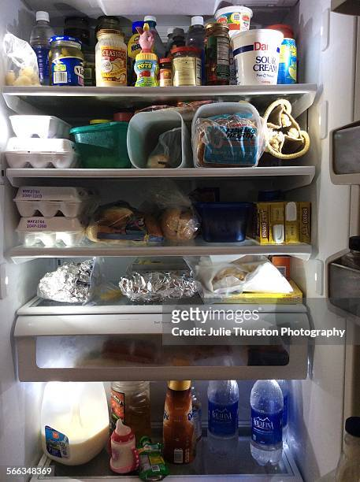
FIM: Motivation
Italians: average 136kg of food waste per year (Statista 2020)
Often hard to keep track of expiring products
Work with new (to us) technologies and components
https://www.statista.com/chart/31072/food-wasted-per-capita-in-european-countries/#:~:text=Each%20person%20in%20the%20EU,from%20the%2027%20member%20states.

Slide 4
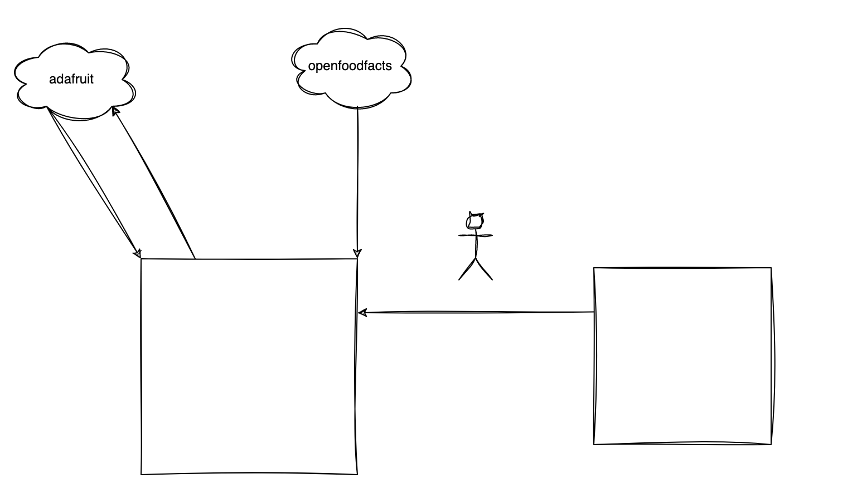
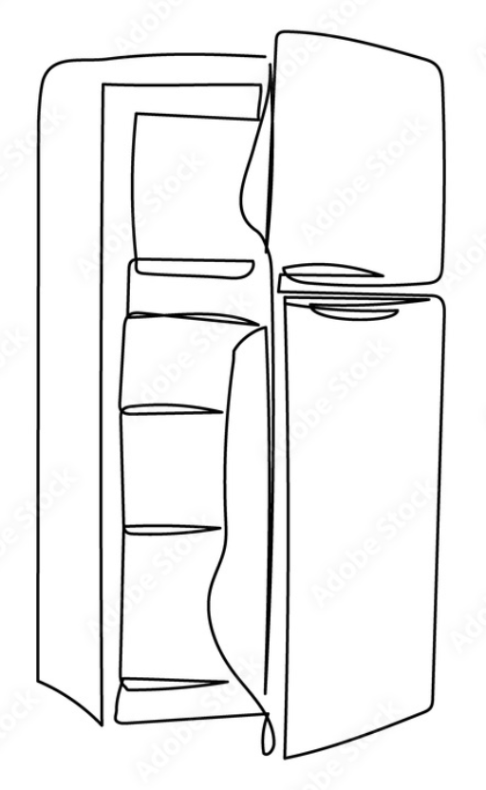
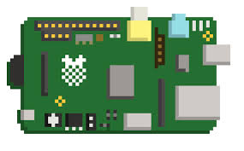
FIM: Overview
FIM & adafruit: Store the inventory in the cloud.
FIM & openfoodfacts: Retrieve product description from barcode
The user tracks items of their fridge using keyboard and scanner.
FIM displays the inventory and highlights expiring items.

Slide 5
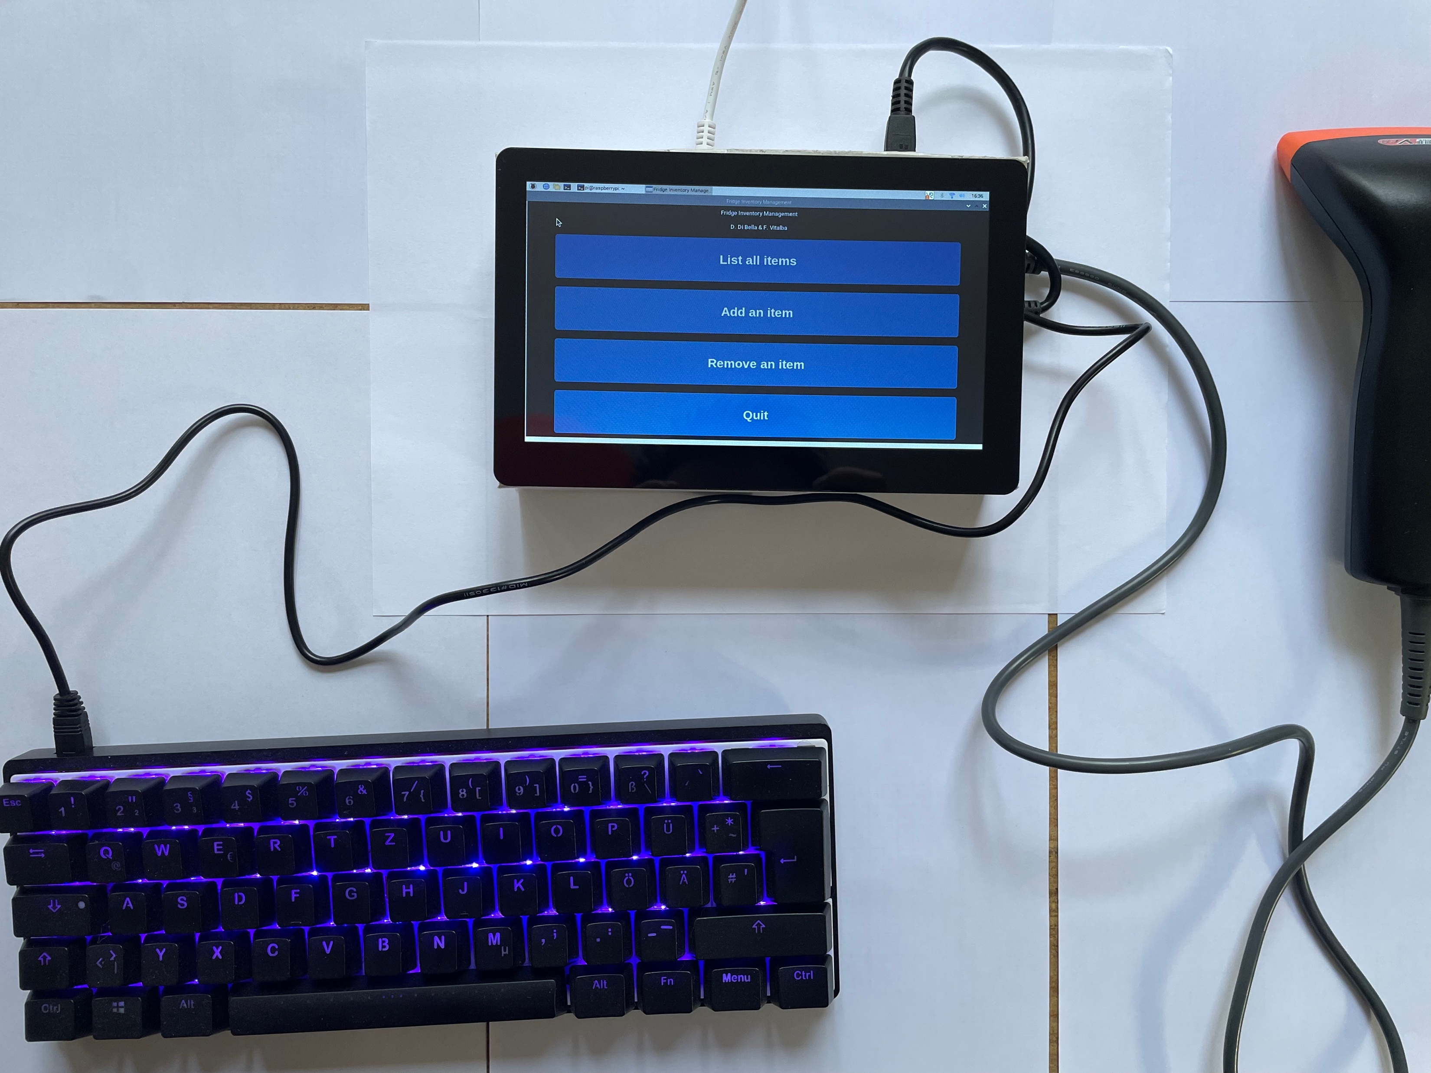
FIM: Components
Inputs:
Touchscreen:
Modes/Commands selection
Scanner:
Inserting data (barcode, quantity, date)
Keyboard:
Inserting data that cannot be represented as a barcode
Adafruit:
Read: persistent storage of items
Outputs:
Display:
Displaying the different screens, item inventory
Adafruit:
Write: persistent storage of items

Slide 6
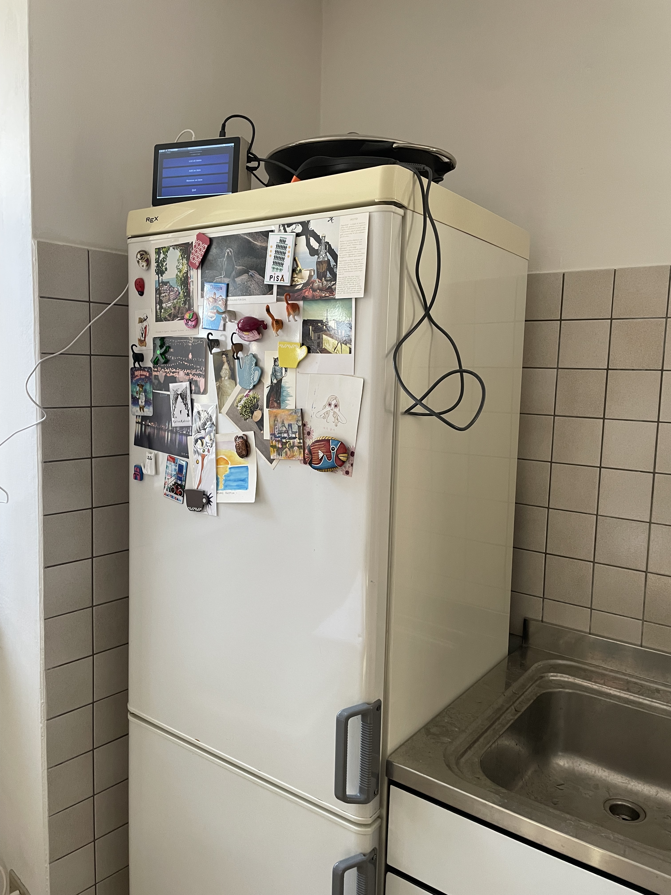
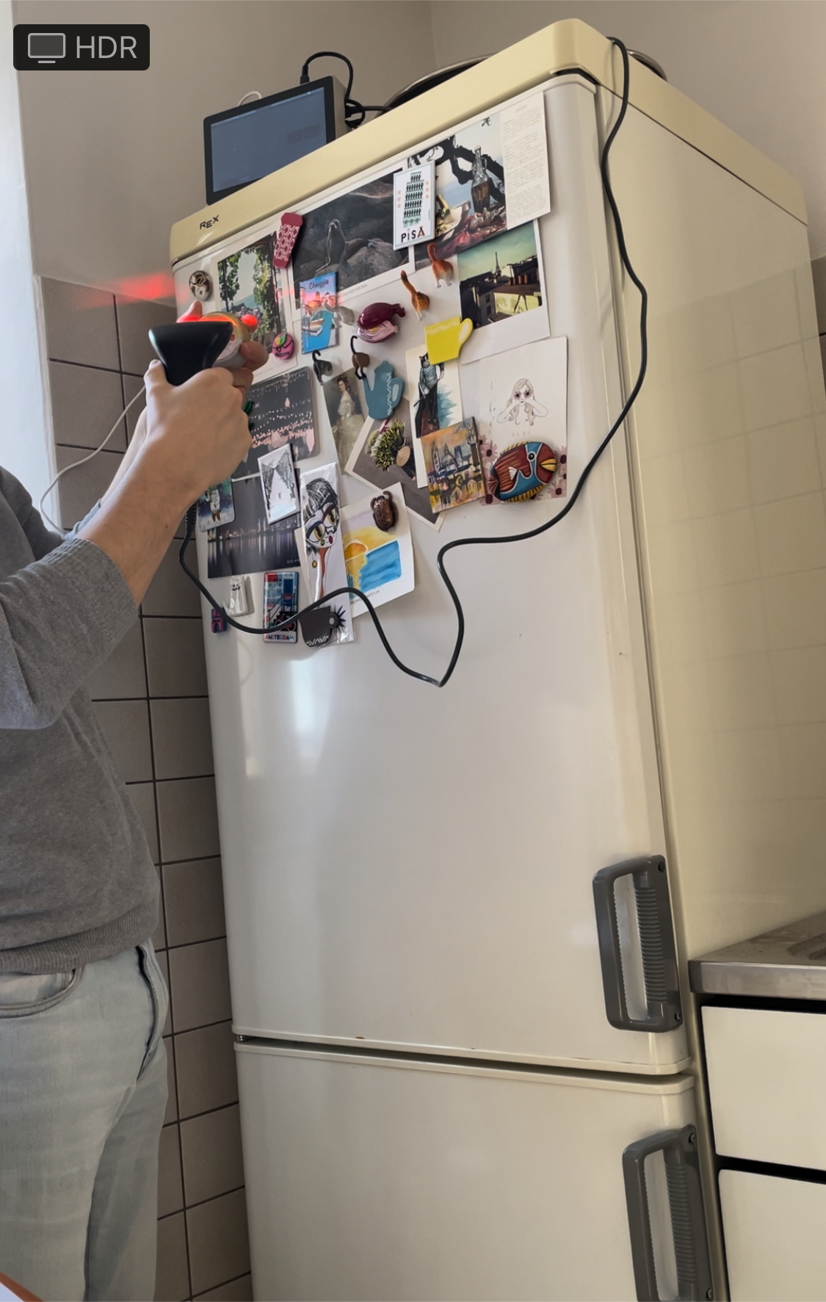
Basics of Physical computing:
Maker Lab
TITLE:
FIM
Group #45
Daniel F. Di Bella
Fabio Vitalba
Faculty of Engineering, Free University of Bozen-Bolzano
fvitalba@unibz.it
ddibella@unibz.it
MakerLab Final project
2023-2024

